Slide 1
Free Space Laser Communication
Preliminary System Proposal
March 12, 2015
Team: Linda Chardee Allee
Brian Bellah
Ian Carr
Jacob Segal
Notes:
Brian

Slide 2
Outline
●Project Proposal
●System Location and Specifics
●Turbulence Parameters
●Beam Characteristics
●Preliminary AOSim2 Modeling
●Preliminary System Design
SolidWorks
Notes:
Brian

Slide 3
Project Proposal
Send a modulated laser pulse across free space where signal is received and decoded for data transfer
Phase modulated binary pulse train selected to study atmospheric phase distortion
Preliminary system location and design proposed for further development
Notes:
Brian

Slide 4
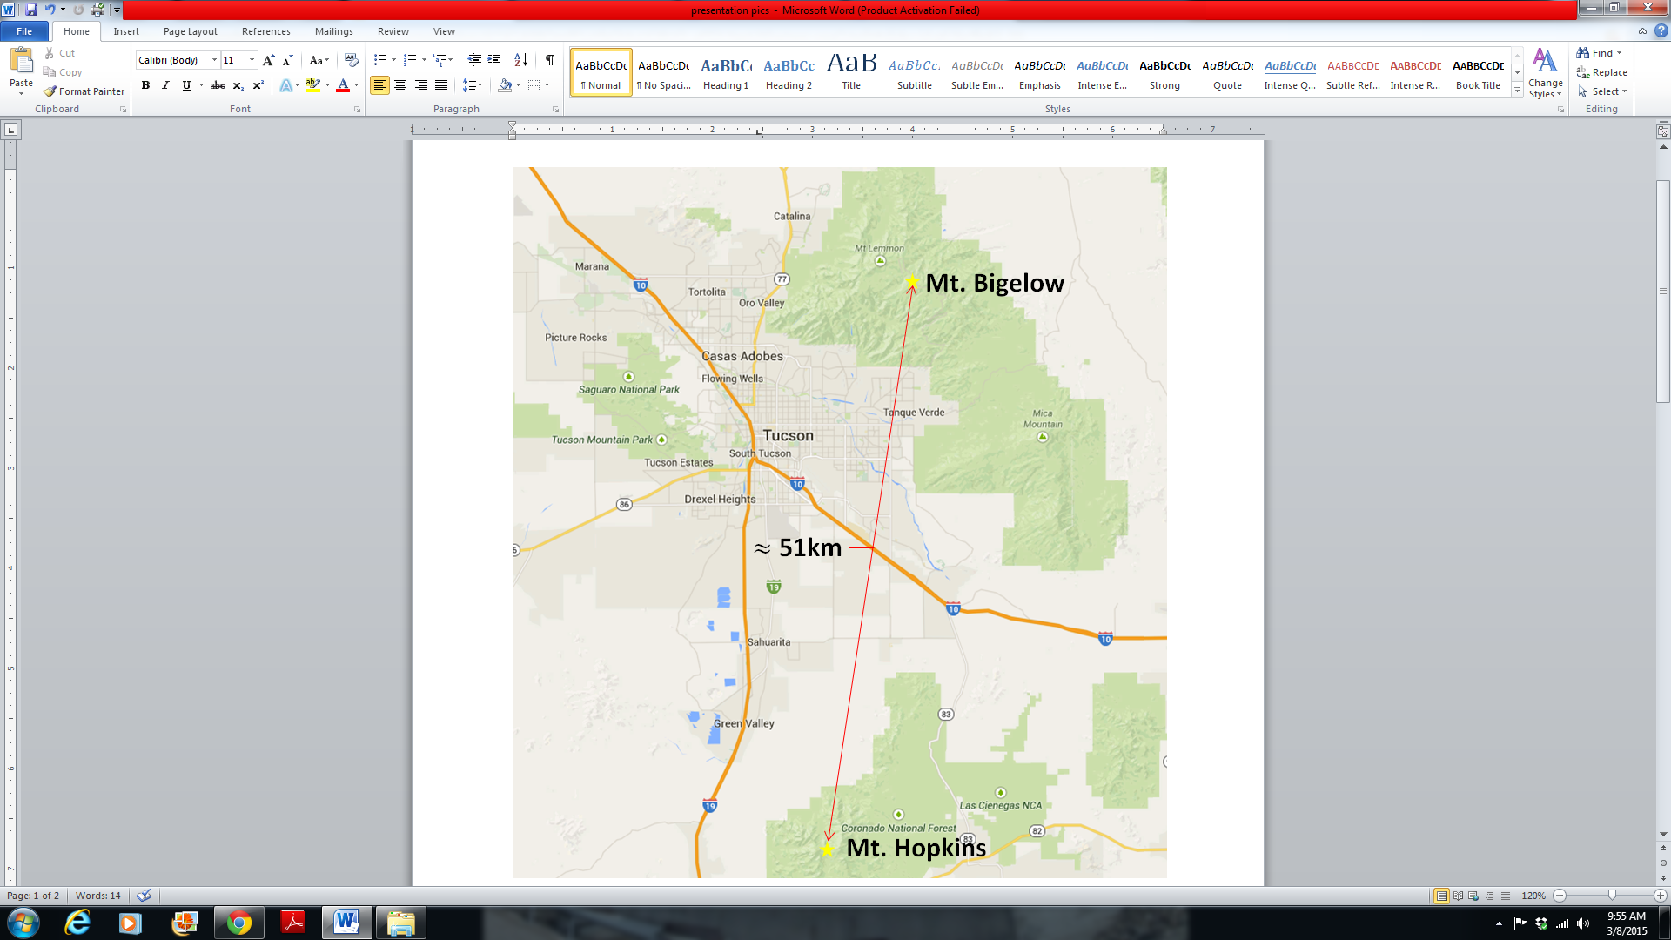
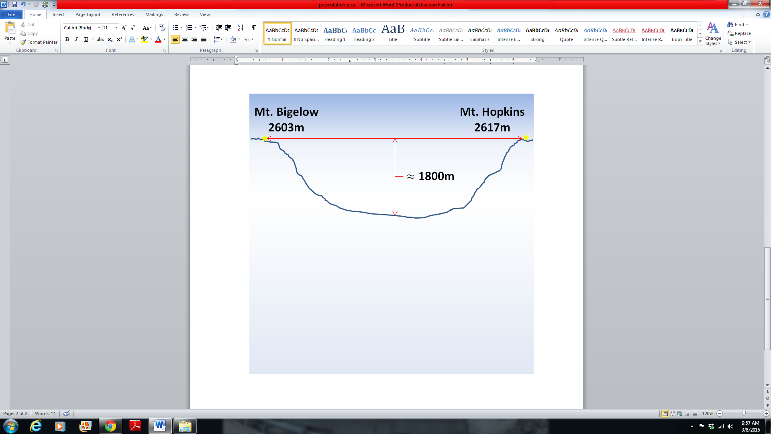
Location Selection
Mt. Hopkins to Mt. Bigelow
Facilities already in place
Uniform location elevation
~2600 m
Ambitious propagation range!
~51 km
Notes:
Brian

Slide 5
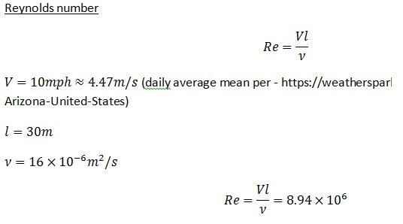
Governing System Parameters
Reynolds Number
Notes:
Brian

Slide 6
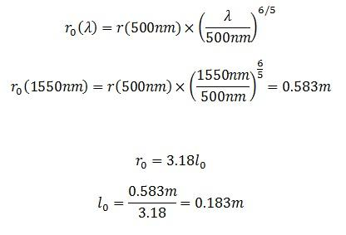
Fried Length, Coherence Length
Notes:
Chardee

Slide 7
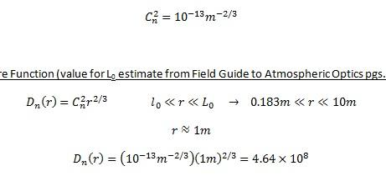
Index Structure Function
Notes:
Chardee

Slide 8
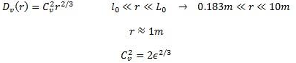
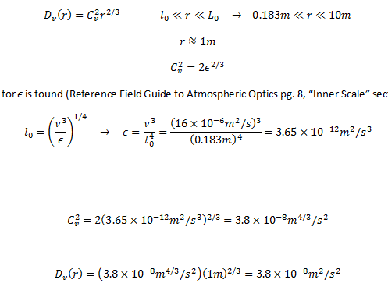
Velocity Structure Function
Notes:
Chardee

Slide 9
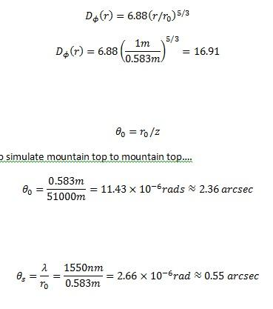
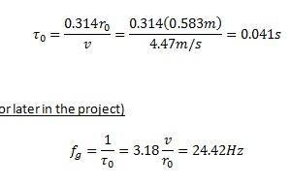
Phase Structure Function, Coherence Time, Greenwood Frequency
Notes:
Chardee

Slide 10
Isoplanatic Angle, Scattering Angle
Notes:
Chardee

Slide 11
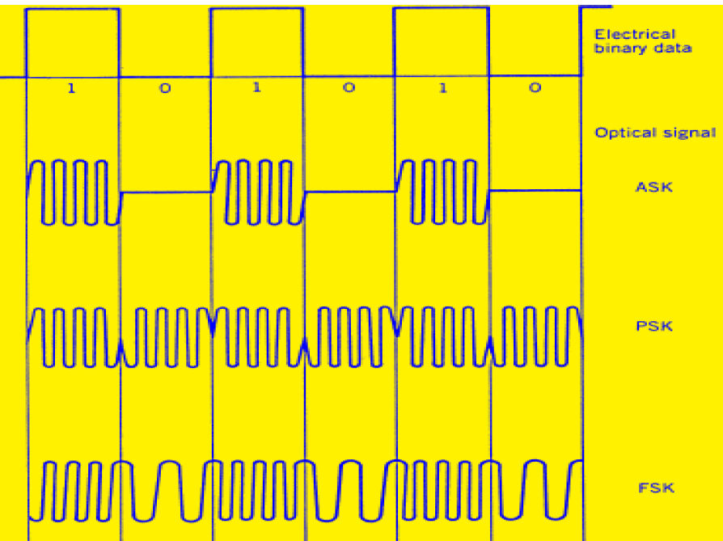
Laser Pulse: Signal Structure
Information encoded in simple binary signal - BPSK
Pulse duration ~ 10 ns
Phase shift keying of optical signal
Chosen to observe atmospheric phase perturbations
Dr. Milorad Cvijetic, “Optical Modulation Formats”
Notes:
Ian

Slide 12
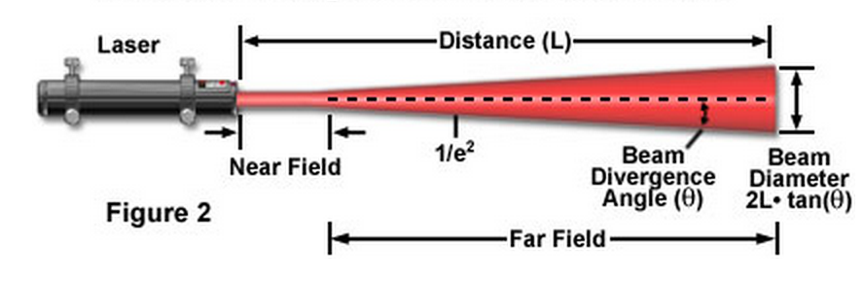
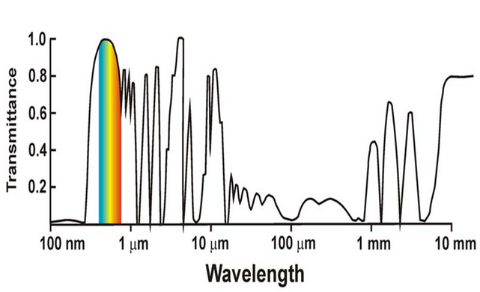
Laser Pulse: Beam Parameters
Classic Gaussian beam profile
TEM00
Operational wavelength
AO SIM2 software was used to compare 900nm to 1550nm performance windows
http://www.olympusmicro.com/primer/techniques/microscopylasers.html
https://www.eeb.ucla.edu/test/faculty/nezlin/SatellitesAndSensors.htm
Notes:
Ian

Slide 13
Beam Parameters/Radiometry
Beam profile 16 inch aperture
Beam divergence 2θ = 4.8μrads
Beam diameter at 51km range, 25 inches
1W signal laser pulse, ≈ 50nW at APD detector
Notes:
Ian

Slide 14
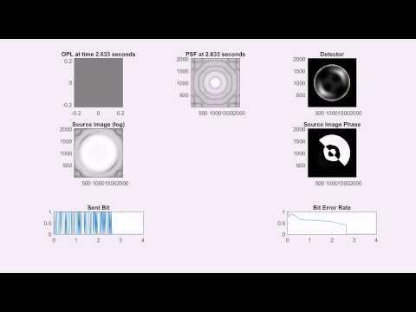
Notes:
Jacob

Slide 15
Simulation Results
Initial Bit Error rate of ~60%
Phase is at the Primary Mirror
Looking into results if light was focused
Notes:
Jacob

Slide 16
Preliminary Design Send/Receive
16-Inch Truss Dobsonian Telescope
Primary Focal Length of 1800 mm
Secondary Mirror Obstruction by Diameter of 22%
Notes:
Jacob

Slide 17
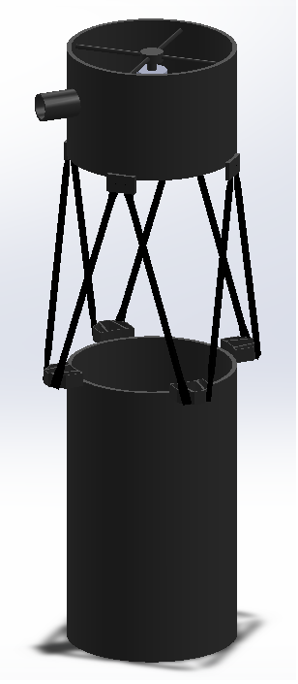
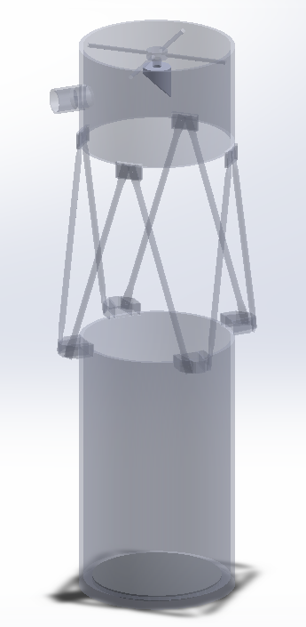
Preliminary Design Send/Receive
Notes:
Jacob

Slide 18
Questions?

